Slide 1

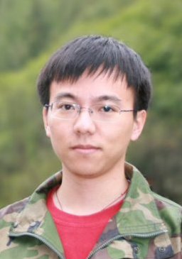
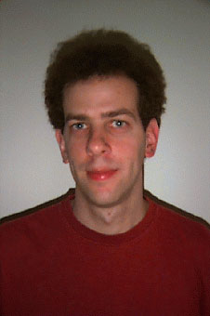
A Geodesic Framework for Fast Interactive
Image and Video Segmentation and Matting
By X. Bai & G. Sapiro
ICCV 2007
a presentation by Pushkar Modi
AI, Robotics and Vision Lab, Dept. of CSE
modi@cs.umn.edu
Xue Bai
Currently pursuing his PhD in EE at the University of Minnesota
Also an intern at Adobe Systems
Guillermo Sapiro
Completed his D.Sc. In EE from Technion, Israel
Now a Professor in the ECE dept. at the University of Minnesota

Slide 2
Segmentation
Which pixels to recognize and which to ignore? [3]
Segmentation of images and video is one of the most fundamental and challenging problems in image processing
A major challenge is that images usually have a lot of data that we do not need and do not have the time to process
Segmentation entails obtaining a compact representation of what is helpful in the image, depending on the task
Idea is to isolate the least number of most suggestive features that confirm the presence of the object in question
Applications: Summarizing video, finding particular objects, finding people, labeling satellite images, searching images

Slide 3
Types of Segmentation
Some popular approaches [4]
Clustering of pixels
Divisive – Entire data set is a cluster, clusters are recursively split
Agglomerative – Each data item is a cluster, clusters are then merged
Graph based
- The image is modeled as a weighted, undirected graph
- Each pixel is a node in the graph, edges formed between every pair of pixels
- The weight of an edge is a measure of the similarity between the pixels
Histogram based
- Very efficient compared to other techniques
- Histogram is computed from all the pixels of the image
- Peaks and valleys define the clusters
Others based on neural networks, edge detection, models, semi-auto, etc.

Slide 4
How are Regions Defined?
Region segmentation is a difficult problem [5]
Reliable segmentation is only possible after significant information has been extracted about the objects portrayed
Methods for extracting the information often require a segmented image thus making it a chicken-and-egg problem. A good alternative is to have user input, if possible
Pixels are assigned to a region based on color, intensity, texture or distance

Slide 5
What is Matting?
Applies to the problem of accurate foreground estimation in
images and video [2]
The matte defines which pixels are foreground and which are background
For pixels along the boundary or in semi-transparent regions such as hair, the matte defines the mixture of foreground and background at each pixel

Slide 6
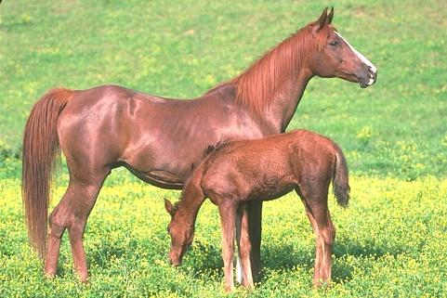
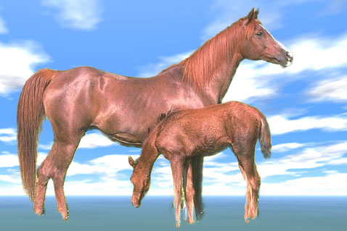
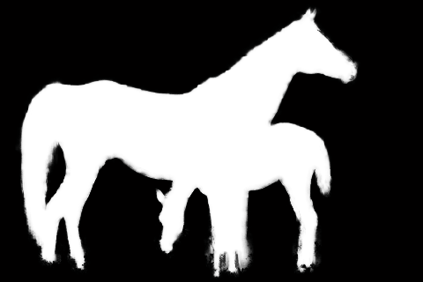

Interactive Image Segmentation
The basic idea [6]
Very little user input
O(N)
High quality results

Slide 7
Features
Highlights from the paper [1]
Rough and minimal input from the user. Just one scribble for labeling the foreground and background. In videos scribble in about 1 out of 70 frames
The geodesic (weighted-distance) computation is linear in time and thereby optimal
The weights are based on simple properties such as spatial and temporal gradients
Weights can be sophisticated depending on the requirements and thus the approach is extensible
Can handle dynamic backgrounds, moving camera and occlusions

Slide 8

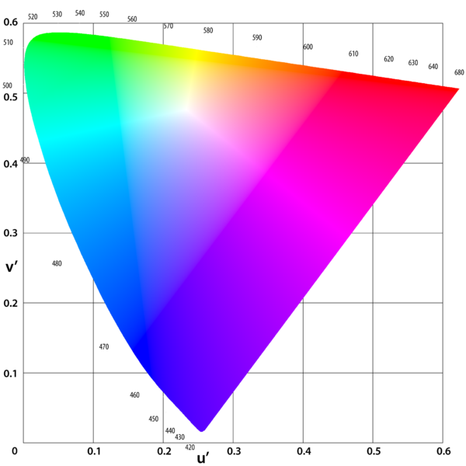





Technique
Step 1 – Define the weight function [1, 6]
Estimate the color distribution on scribbles (via non-parametric kernel density estimation)
Each pixel is assigned a probability to belong to F or B

Slide 9
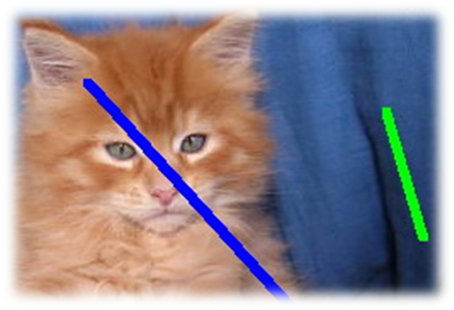




Technique
Step 2 – Weighted distance transform [1,6]
For a given point x, we compute the geodesic distances from every point of the closest scribbles to find a minimum

Slide 10
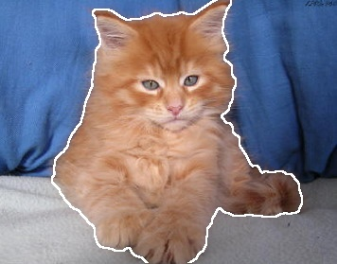
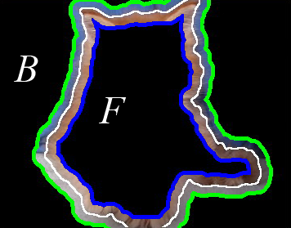
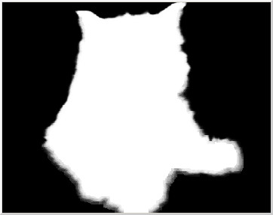
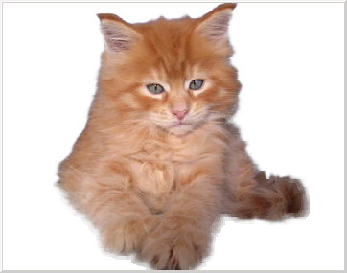
Technique
Step 3 – Alpha matte estimation [1, 6]
Automatically create a narrow band and new scribbles. Band boundaries serve as “new scribbles”
Locally estimate the alpha values inside the band
extracted object
alpha matte

Slide 11

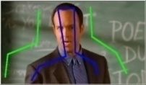
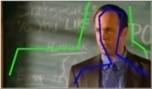
Video
Implementation and challenges in video [1, 6]
Scribbles propagate in spatial-temporal space
No explicit optical flow
Additional constraints applied to overcome ambiguity
t

Slide 12
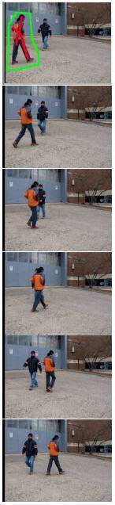
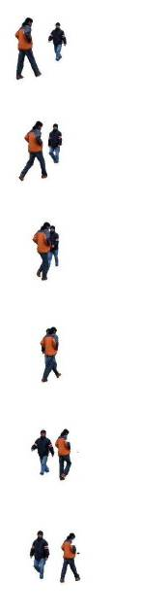
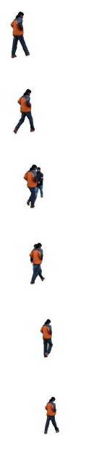
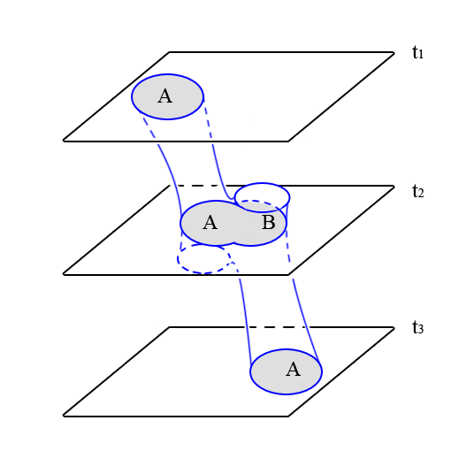
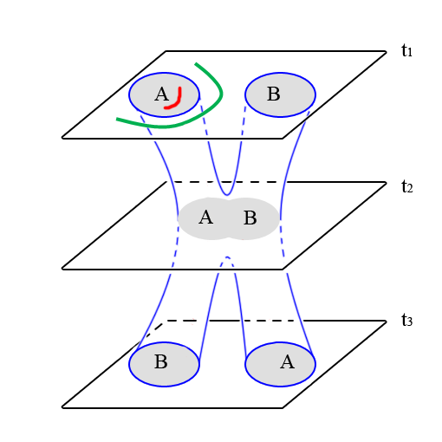
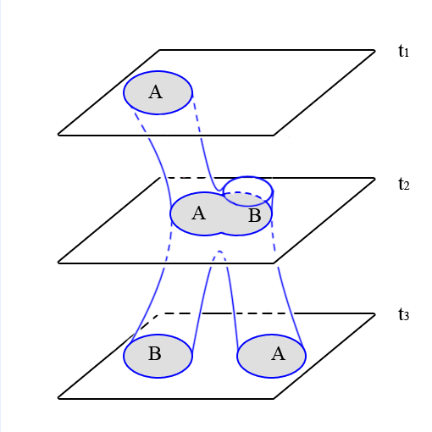
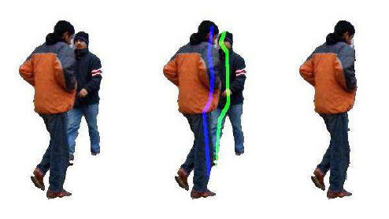


Additional Challenge in Videos
A
B
Adding scribbles to separate the two people in just a few frames.
Constrained propagation

Slide 13
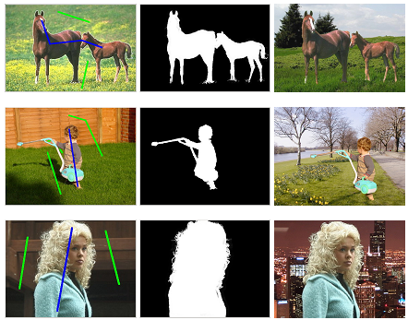
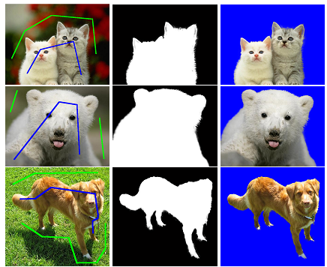
Results
For still images [6]
original alpha matte composite
original alpha matte composite

Slide 14
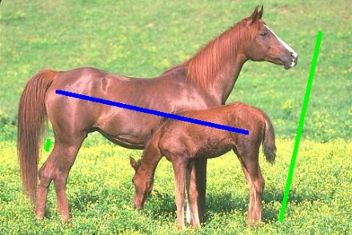
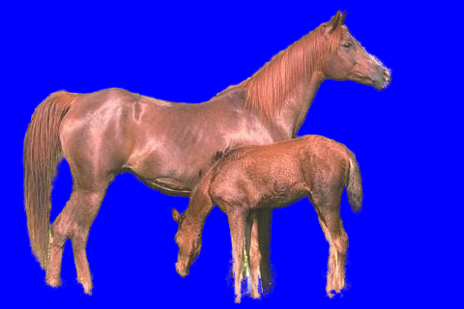
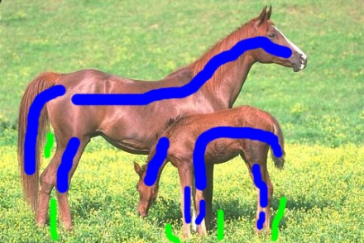
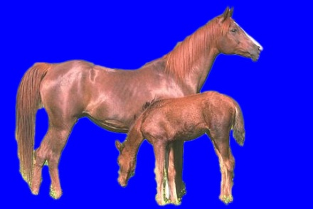
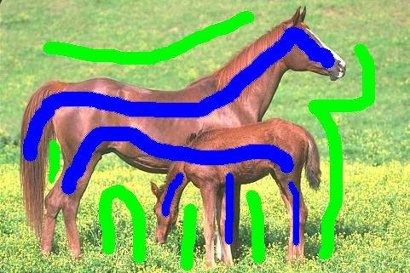
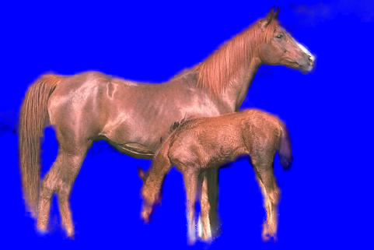
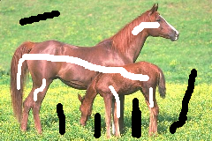
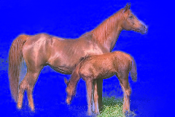
Comparisons
With the state of the art [6]
Our result
Photoshop CS3 Quick Selection Tool
Wang and Cohen, ICCV’05
Spectral Matting (Levin, et al.)

Slide 15
References
Xue Bai, Guillermo Sapiro, A geodesic framework for fast interactive image and video segmentation and matting. IEEE ICCV 2007, Brazil.
http://www.worldscibooks.com/compsci/n114.html
D. Forsyth, F. Ponce, Computer Vision: A Modern Approach, 2007
http://en.wikipedia.org/wiki/Segmentation_(image_processing)
N. Papanikolopolous, CV class notes, University of Minnesota
X. Bai, Powerpoint presentation of [1]

